Slide 1
Cloud Security

Slide 2
Cloud Computing Security Challenges
Cloud computing security challenges fall into three broad categories:
Data Protection
> Securing your data both at rest and in transit.
User Authentication
> Limiting access to data and monitoring who accesses the data.
Disaster and Data Breach
> Contingency Planning.

Slide 3
SECURITY ISSUES IN CLOUD COMPUTING
Data breaches:
> It is an incident in which sensitive, protected or confidential data has potentially been viewed, stolen or used by an individual unauthorized.
Data loss:
> Valuable data disappear into the ether without a trace.
Account or service traffic hijacking:
> An attacker gains access to your account, he or she can eavesdrop on your activities and redirect your clients to illegitimate sites.
Insecure interfaces and APIs:
> Cloud computing providers expose a set of software interfaces or APIs that customers use to manage and interact with cloud services.

Slide 4
SECURITY ISSUES IN CLOUD COMPUTING
Denial of service:
> DoS outages can cost service providers customers and prove pricey to customers who are billed based on disk space consumed.
Malicious insiders:
> It can be a current or former employee, a contractor, or a business partner who gains access to a network, system, or data for malicious purposes.
Cloud abuse:
> A bad guy using a cloud service to break an encryption key which is too difficult to crack on a standard computer.
Shared technology vulnerabilities:
> Cloud service providers share infrastructure, platforms, and applications to deliver their services in a scalable way.

Slide 5
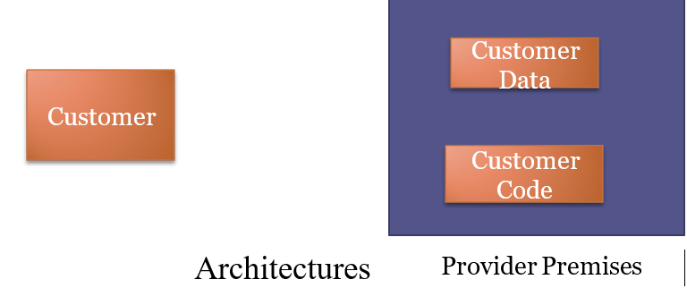
Security a major Concern
Security concerns arising because both customer data and program are residing in Provider Premises.
Security is always a major concern in Open System

Slide 6
Questions Major
How much secure is the Data?
How much secure is the Code?

Slide 7
Are both Data and Code safe?
How to ensure
Very hard for the customers to actually verify the currently implemented security practices and initiatives of a cloud computing service provider because the customer generally has no access to the provider’s facility which can be comprised of multiple facilities spread around the globe.
Solution:
Provider should get some standard certificates from some governing institution that ensure users that provider has established adequate internal control and these control are operating efficiently.

Slide 8
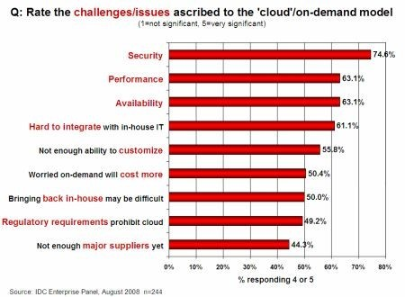
Security Is the Major Challenge

Slide 9
Dangers and Vulnerabilities
Security is to save data and program from danger and vulnerability
Dangers
  Disrupts Services.
  Theft of Information.
  Loss of Privacy.
  Damage information.
Vulnerabilities
  Hostile Program.
  Hostile people giving instructions to good programs.
  Bad guys corrupting or eavesdropping on communications

Slide 10
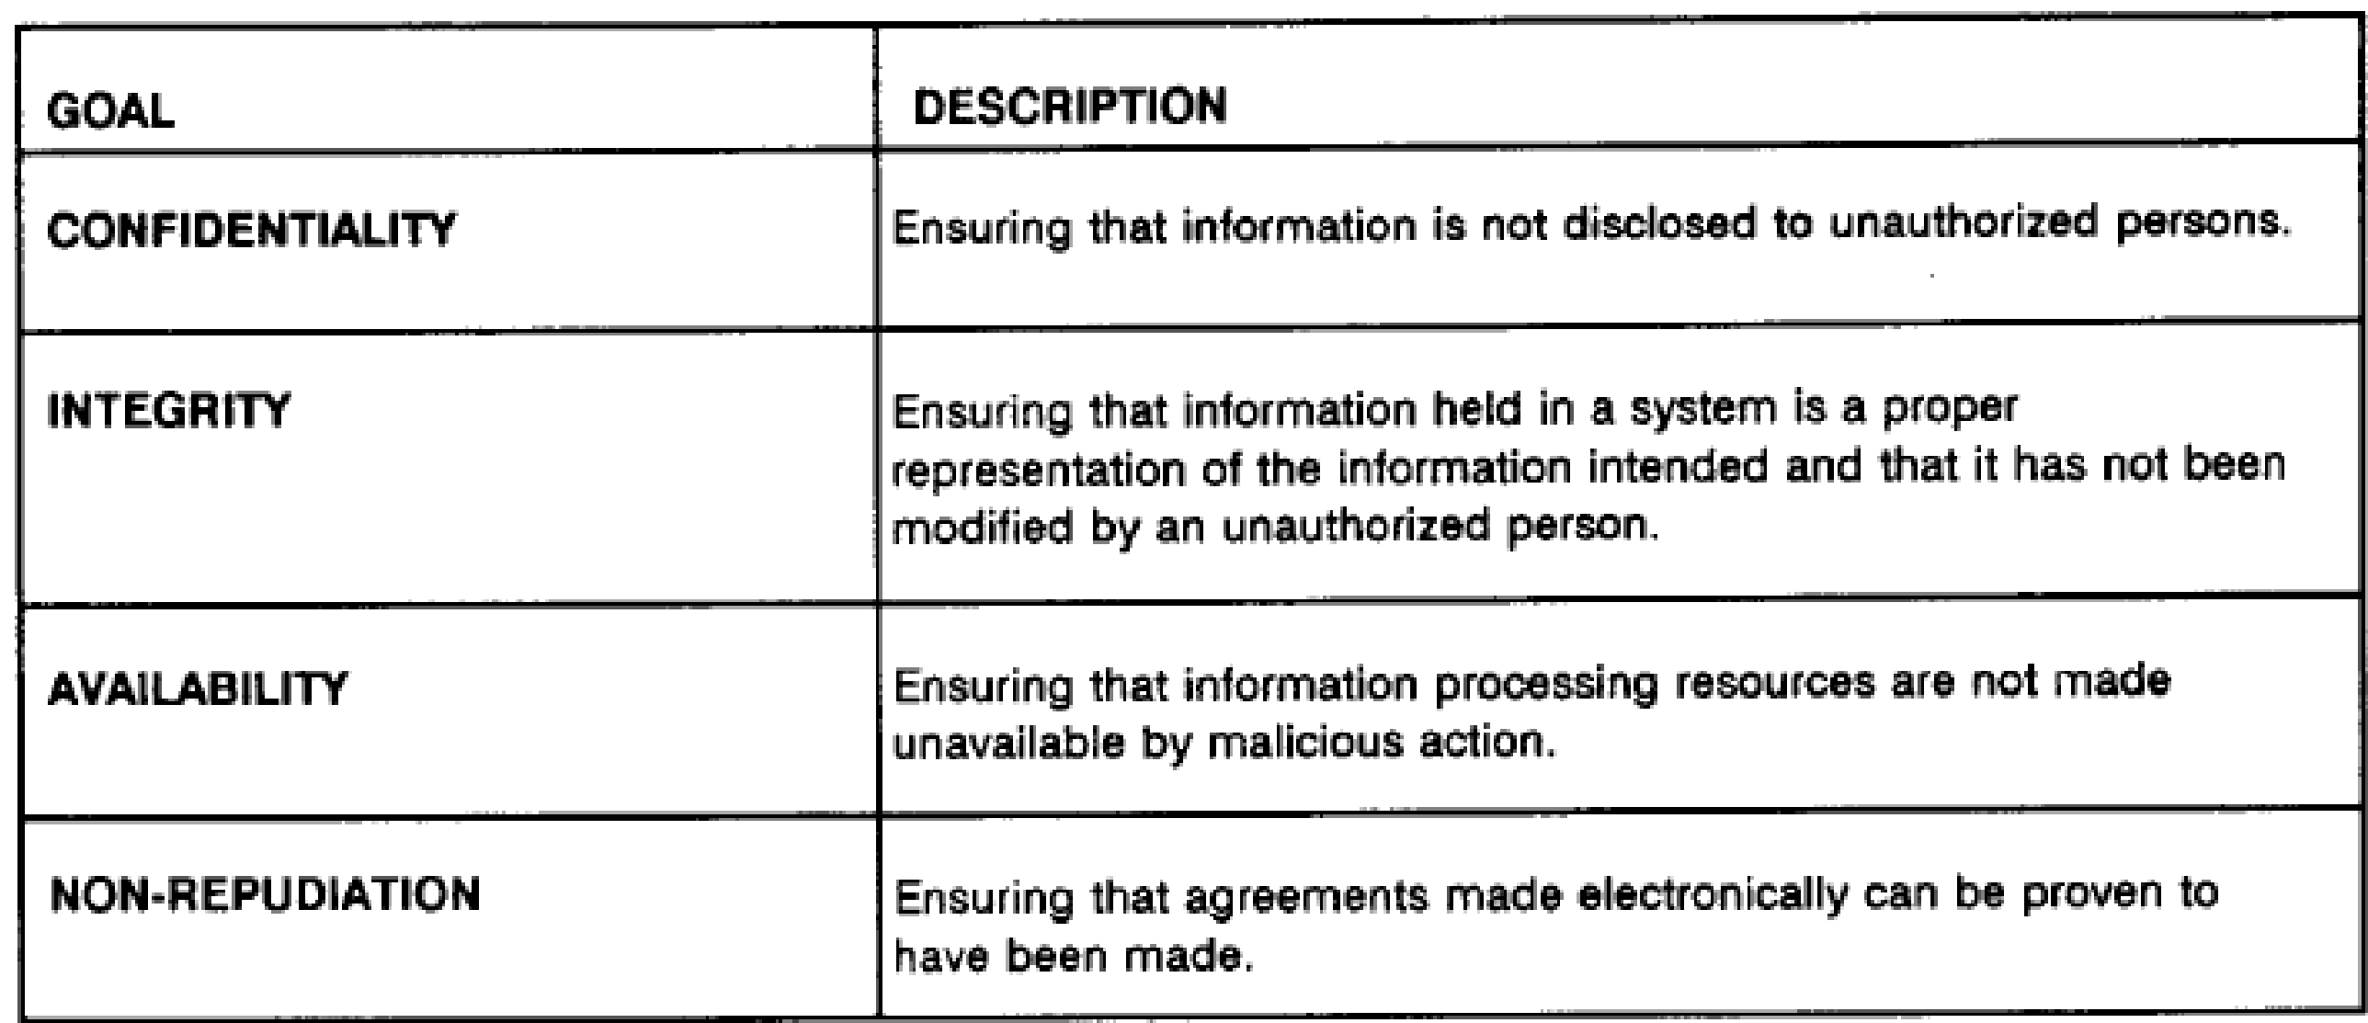
Common Security Requirements

Slide 11
Security at Different Levels
We need Security at following levels:
Server access security
Internet access security
Database access security
Data privacy security

Slide 12
Another Question:
How much safe is data from Natural disaster?
  Data can be redundantly store in multiple physical location.
  Physical location should be distributed across world.

Slide 13
Data centre Security?
Professional Security staff utilizing video surveillance, state of the art intrusion detection systems, and other electronic means.
When an employee no longer has a business need to access datacenter his privileges to access datacenter should be immediately revoked.
All physical and electronic access to data centers by employees should be logged and audited routinely.
Audit tools so that users can easily determine how their data is stored, protected, used, and verify policy enforcement.

Slide 14
Backups of Data
Data store in database of provider should be redundantly store in multiple physical location.
Data that is generated during running of program on instances is all customer data and therefore provider should not perform backups.
Control of Administrator on Databases.

Slide 15
Data Sanitization
Sanitization is the process of removing sensitive information from a storage device.
What happens to data stored in a cloud computing environment once it has passed its user’s “use by date”
What data sanitization practices does the cloud computing service provider propose to implement for redundant and retiring data storage devices as and when these devices are retired or taken out of service.

Slide 16
Some virus and worm create
Job Starvation Issue :
  where one job takes up a huge amount of resource resulting in a resource starvation for the other jobs.
Solutions:
Advanced reservations of resources
priority reduction

Slide 17
Information Security
Security related to the information exchanged between different hosts or between hosts and users.
This issues pertaining to secure communication, authentication, and issues concerning single sign on and delegation.
Secure communication issues include those security concerns that arise during the communication between two entities.
These include confidentiality and integrity issues. Confidentiality indicates that all data sent by users should be accessible to only “legitimate” receivers, and integrity indicates that all data received should only be sent/modified by “legitimate” senders.
Solution: public key encryption, X.509 certificates, and the Secure Sockets Layer (SSL) enables secure authentication and communication over computer networks.

Slide 18
Management Related Issues
Management is important as the cloud is heterogeneous in nature and may consist of multiple entities, components, users, domains, policies, and stake holders.
Credential Management:Credential management systems store and manage the credentials for a variety of systems and users can access them according to their needs.
Secure and safe storage of credentials is equally important.

Slide 19
How secure is encryption Scheme
Is it possible for all of my data to be fully encrypted?
What algorithms are used?
Who holds, maintains and issues the keys? Problem:
Encryption accidents can make data totally unusable.
Encryption can complicate availability
Solution
The cloud provider should provide evidence that encryption schemes were designed and tested by experienced specialists

Slide 20
Thank you

